Slide 1
Chapter 11
Analysis and management of health and wellness programs and offerings
Dr. Bendegul Okumus
Heather Linton Kelly

Slide 2
Learning Outcomes
Describe what wellness programs and offerings that Arctic Bath Hotel and Spa provides to their guests.
List and explain what wellness programs and offering hospitality and tourism businesses can offer to their guests.
Explain and discuss key performance indicators to measure the success of these wellness offerings.
Describe different ways to gather data related to customer feedback.

Slide 3

Case Study: Arctic Bath Hotel and Spa, Sweden
For more information about the Arctic Bath Hotel and Spa, click here.

Slide 4

Wellness Programs & Offerings in Hospitality
Wellness Destination Management and Analysis
Spa & Hot Springs Management and Analysis
Wellness Facility & Amenity Management and Analysis
Wellness Event Management and Analysis
Notes:
Image from https://patch.com/california/berkeley/seven-dimensions-wellness-seniors

Slide 5
Meeting and Exceeding Customer Expectations
Following Pine & Gilmore’s Experience Economy, 5 Wellness Design Principles:
Theme the wellness experience
Harmonize wellness impressions with positive cues
Eliminate negative cues
Mix in memorabilia
Engage all five senses in designing and delivering wellness experience

Slide 6

Meeting and Exceeding Customer Expectations

Slide 7
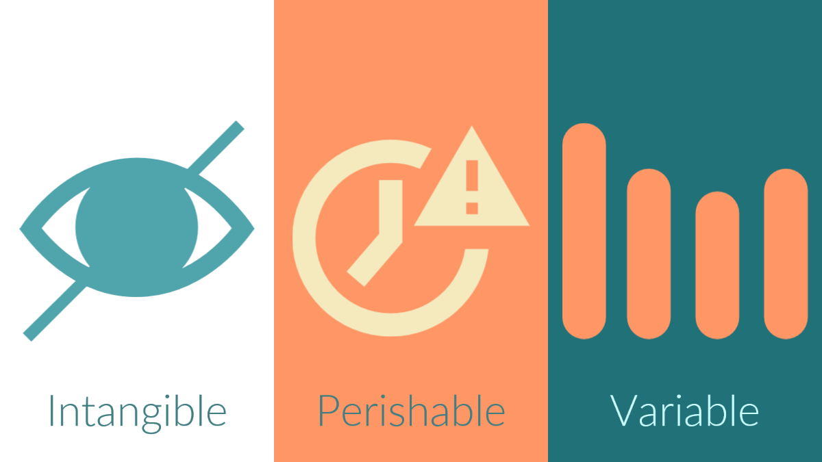
Characteristics of Services
Standard Operating Procedures (SOPs)
Training

Slide 8
Key Performance Indicators (KPIs)
Capture rate (the percentage of guests who use spa services)
Average treatment rate
Treatment room utilization
Therapist productivity
Revenue per guest
Revenue per square foot
Revenue per occupied guest room
Number of services per guest
Retail sales as a percentage of treatment revenue
Market segmentation
Revenue per available treatment hour (RevPATH)
Revenue per available treatment room

Slide 9

Methods of Evaluation: 5 Ps

Slide 10

Data Gathering & Analysis
Customer/Guest Satisfaction Surveys
Focus Groups & Personal Interviews
Natural Experiments
Online Reputation Management
Using the Data and Taking Actions

Slide 11
Summary
Experiences go beyond commodities, good, and services, and into a tailored situation that be thought of almost like an interactive performance, where customer participate and connect with the event at hand.
There are five design key principles related to experience: theme the experience, harmonize impressions with positive cues, eliminate negative cues, mix in memorabilia, and engage all five senses.
Services are intangible, variable, and perishable. They are also produced and consumed simultaneously.
Tools available to address service concerns include Standard Operating Procedures (SOPs) and training.

Slide 12
Summary
Training should thorough and delivered in a professional, detailed manners and include follow-up resources.
Key Performance Indicators (KPIs) monitor the performance of wellness facilities, programs, and offerings. They include treatment room utilization, revenue per guest, revenue per available treatment room, and many more.
One method of evaluating a wellness program is the Five P’s of Evaluation: participants, personnel, programs and offerings, place, and paperwork.
Wellness customer surveys are self-administered and use rating scales to understand how happy clients were with the wellness products, services, and experiences.

Slide 13
Summary
Focus groups and natural wellness experiments are also ways to gather data on wellness products, services, and experiences.
A natural well experiment is one that is carried out during a regular course of events where one change is made to the experience and the resulting satisfaction is compared to the consistent experience
A production description manual includes a list of ingredients and descriptions for every product sold or used in the facility, along with their uses, benefits, and contraindications.
A treatment protocol manual is a detailed manual for each of the treatments and services offered in a spa, with information on the products used, and the timing and steps for each treatment.

